Slide 1
Project Presentation on :
Intelligent Question Paper Generator System
GUIDED BY:
Prof. NITESH TEJRA
TEAM MEMBERS:
AANCHAL JAWERE (EN16CS301002)
ANCHAL SONI (EN16EL301041)

Slide 2

Basic Introduction
Intelligent Question Paper Generator System takes a simple text , a document or a pdf file properly written in english as an input and provides a list of questions as an output.
The system is fast and secure to generate wh-questions in a random way.
Natural Language Processing(NLP) technology is used for preparing the proposed system.

Slide 3
Problems in existing scenario
Intelligent Question Paper Generator
Manual labour: Challenging and time taking task.
Patterns or repetitions: It becomes easy to guess question paper.
Low security as paper is not secured using any mechanism.
Slow as human labour is involved.
Less variety of different types of questions.
Storage is an issue
No manual labour: required.All task done by machine.
Unbiased: No issue of pattern repetition.
Highly secure.
Fast: Generates output within minutes.
Variety: Offers a large variety.
Storage: No issue of storage.

Slide 4
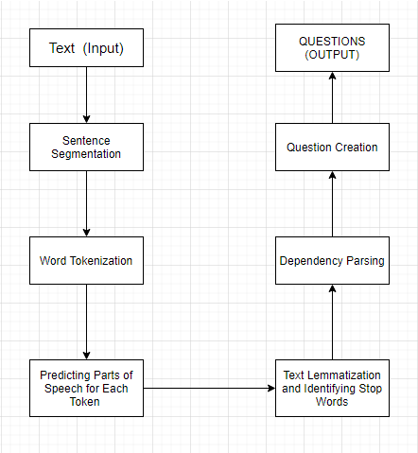
Proposed System
What does our program do?
The Intelligent Question Paper Generator System takes a simple text , a document or a .pdf file as an input and provides a list of ‘wh’ questions as an output following 6 major steps in between. Process that is followed for generating questions has the following steps -
1.
6.
2.
5.
3.
4.

Slide 5
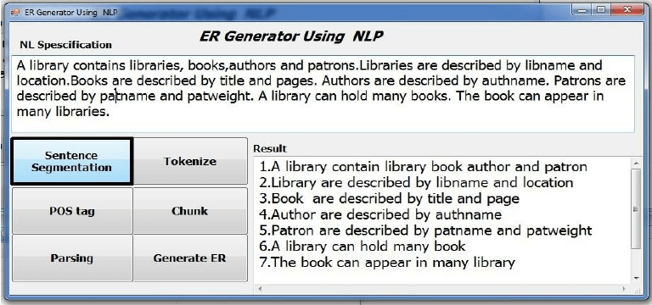
1. SENTENCE SEGMENTATION EXAMPLE

Slide 6
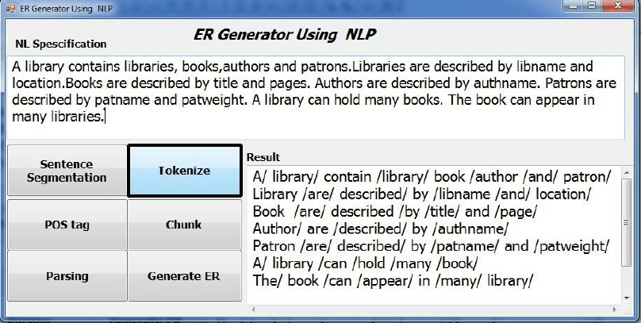
2. WORD TOKENIZATION EXAMPLE

Slide 7
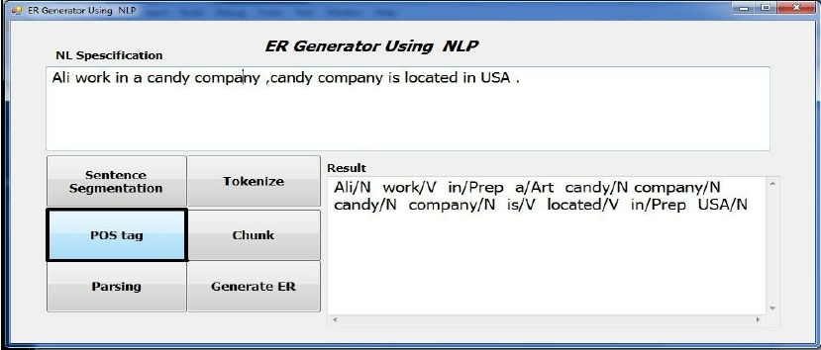
3. PREDICTING PARTS OF SPEECH TAGGING EXAMPLE

Slide 8
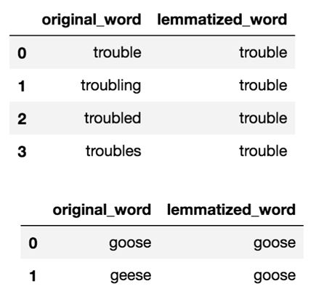
4. TEXT LEMMATIZATION & IDENTIFYING STOP WORDS

Slide 9
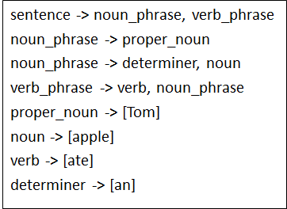
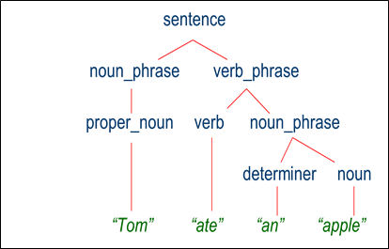
5. DEPENDENCY PARSING EXAMPLE
Sentence: Tom ate an apple.
Grammar
Parse tree

Slide 10
Technology Stack
Language – Python
IDE- Spyder (python version 3.7)
Technology - Natural Language Processing
Libraries–Spacy,NLTK

Slide 11
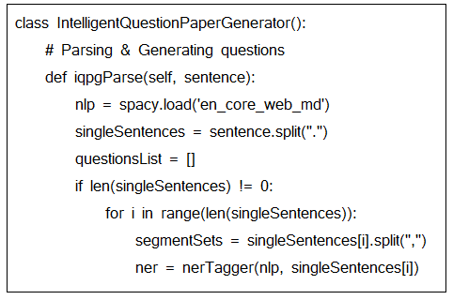
Implementation
INTERFACE
DESIGN

Slide 12
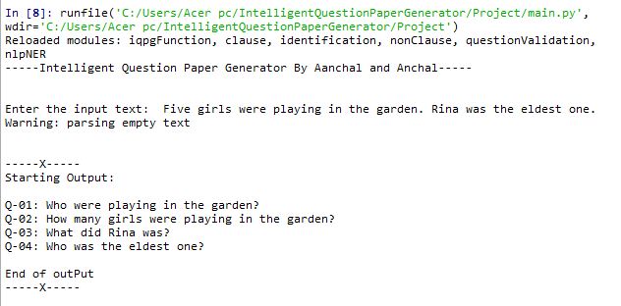
Output from direct Input-
Test Cases:

Slide 13
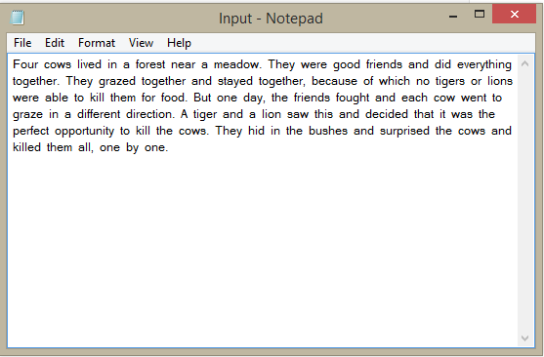
Test Cases:
INPUT -

Slide 14
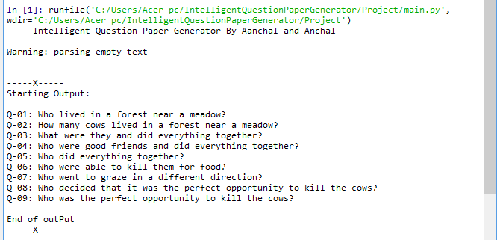
OUTPUT -

Slide 15
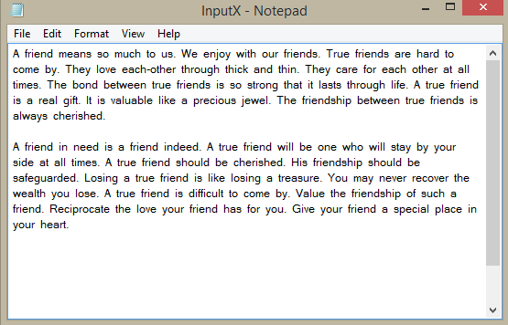
Test Cases:
INPUT -

Slide 16
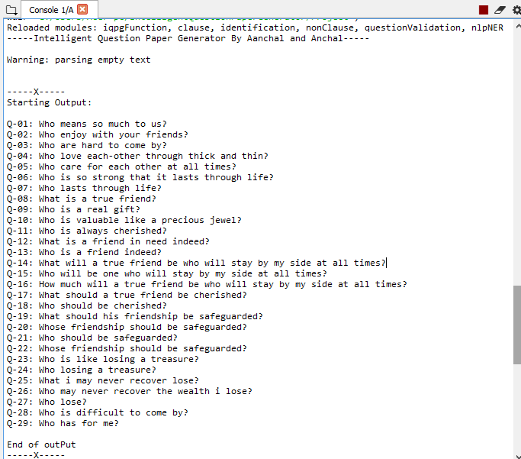
OUTPUT -

Slide 17
How to Improve this Program
We can use a dataset of text and questions along with machine learning to ask better questions.
Further, we can add complex semantic rules for creating long and complex questions.
We can use pre-tagged bag of words to improve part-of-speech tags.

Slide 18
Table-1. Comparative analysis of various algorithms which generates automatic question generation systems
S No. | Algorithm | Methodology | Type of Question | Language | Evaluation and Result
1. | Automatic question generation in the form of Polar Questions | Content selection and Question formation | Question generation like Yes/No type Questions | English | Manually selection of sentences and adding Do in front of the questions.
2. | Automatic question generation in The form of fill-in-the-blanks | Select Labels and proceed | Fill-in-the-blanks type questions | English | Questions are generated in the form of fill-in-the-blanks.

Slide 19
contd...
S No. | Algorithm | Methodology | Type of Question | Language | Evaluation and Result
3. | Automatic Generation of Question Paper from Question pool(Database) | Knowledge Descriptor, Questions Generator, and E- learning Executer | Question generation like Why, when, where, In which(user specific) | English(user specific) | Manually evaluated according to the ques ppr marking scheme.
4. | Automatic Question Paper Generation using NLP | Input sentence, Feature Extraction through SRL, NER, Choose MCS, Test Sentence pattern and Test the Question type pattern | WH questions like who, when, where, why, and how. | English | The percentage of truly generated patterns increased 87% which appears to be promising ratio in this problem comparing it to other techniques used in generating questions automatically.

Slide 20
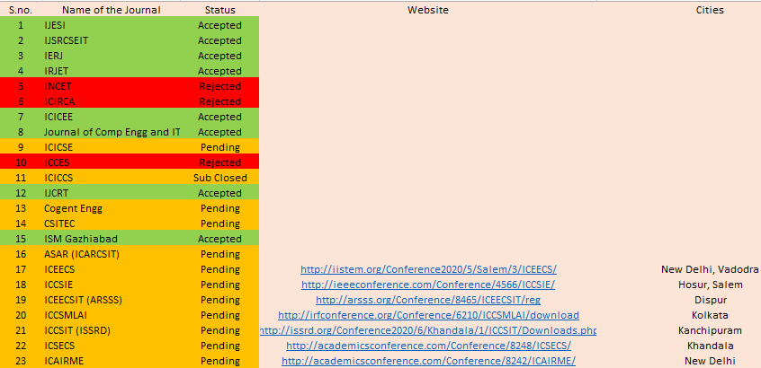
List of Publications

Slide 21
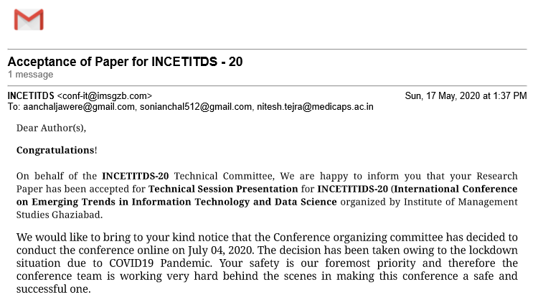
Acceptance Letter for paper publication

Slide 22
CONCLUSION
CONCLUSION
FUTURE SCOPE
REFERENCES
CONTEXT
NLP is used to process the text and NER. Since most of work is done in English language so Automatic question generation system is an open area where still there is a scope of a research and for proposing methodologies by identifying complexities and type of question
Extendable to generate yes/no type questions and fill in the blanks type questions.
Further Intelligent answer copy checking systems can be added for checking the answer sheets and providing the result to the student.
Fenil Kiran Gangar, Hital Gopal Gori, Ashwini Dalvi,” International Journal of Computer Applications” (0975 – 8887) Volume 166 – No.10, May 2017 42
Himanshu Jethwani, Mohd Shahid Husain, Mohd Akbar, “International Journal for Innovations in Engineering, Science and Management”, Volume 3, Issue 4, April 2015.

Slide 23
Thank You
Open For Questions….

